Slide 1
Updates on the Economy for Shell Club15
For internal use only: Confidential
27 AUG 2020

Slide 2
Philippine Economic picture 2020
As of end June 2020, Philippine debt at P 9.05 trillion (32% external, 68% domestic)
July unemployment rate @ 45.5 % (27.3mln jobless) from 5.1% in Jan (per SWS)
Philippines's GDP growth is at -9% in first half 2020 and est.-5.5 FY (6.5% in 2021)*
Philippines's inflation rates forecasted at 2.2% in 2020 (2.4% in 2021)*

Slide 3
Govt Four Pillar strategy to respond to COVID crisis
Pillar 1 – Emergency Support for Vulnerable Groups (SAP)
P 595.62 bln (3.1% of GDP)
Pillar 2 – Resources to fight COVID
P 58.63 bln (0.3% of GDP)
Pillar 3 – Fiscal and Monetary actions
P 1.09 trillion (5.7% of GDP)
Pillar 4 – Economic Recovery plan
P 846.59 bln (4.4% of GDP)
Source: NEDA

Slide 4
Phased recovery approach 2020
Pillar 1 and 2 (Bayanihan I Law)
Subsidy to poor and low income
Small business support (grace period, wage subsidy)
Support to key sectors (agri, OFW, frontliners)
Health system capacity and insurance
Pillar 3 and 4 (Bayanihan II, CREATE, FIST, GUIDE)
Reprioritisation of 2020 budget
Priority BBB resumption
Demand side to raise income and create jobs
Supply side to support firms (liquidity and equity infusion, guarantee thru financial sector
Targeted tax incentives
Reductions in BSP interest rates and RRR, cap on credit card interest rates
Source: NEDA

Slide 5
Phased recovery approach 2021 onwards
Plan for a healthy and resilient PH
Reprioritisation of the 2021 and 2022 budget
Structural reforms to turn crisis into opportunity to prepare for the new normal
Support Balik Probinsya, Bagong Pag-asa (BP2) program

Slide 6
Economic plan looks good but slow, not enough ….
ARISE bill (Accelerated Recovery and Investments Stimulus for the Economy) P 1.3 trillion stimulus vs DOF P 165 bln Bayanihan 2
CREATE bill (Corporate Recovery and Tax Incentives for Enterpises)
Reduction of corp income tax from 30 to 25% but lower ecozone granted incentives has been encountering resistance from business and PEZA
New Taxes – (e-commerce, junk food, etc) – will stifle consumption, inflationary?
Transformation plan – do we have the people to execute, e.g. DICT, DOTr, IATF

Slide 7
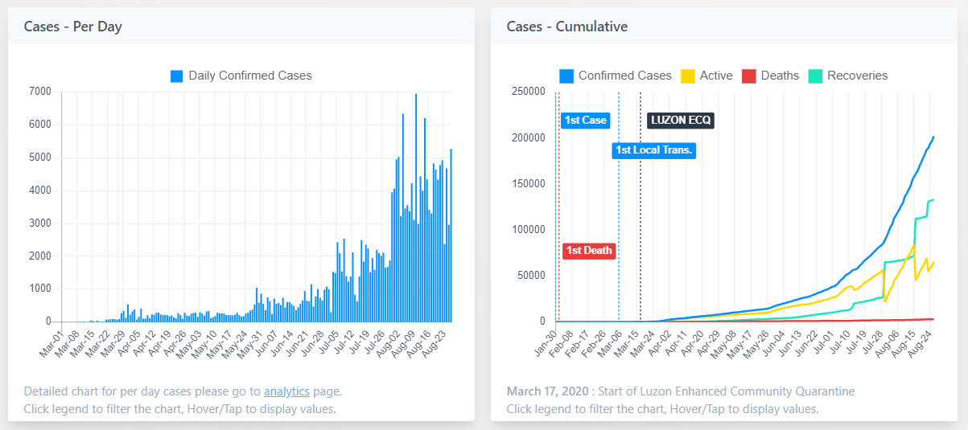
COVID 19 as of 26 Aug 2020 (PDRF)
PDRF SITUATIONAL REPORT 162: CORONAVIRUS DISEASE 2019 (COVID-19)
As of 26 August 2020 | 7:00 PM
COVID-19 UPDATES

Slide 8
Issues with COVID 19 (mis)management
We are still behind testing (both capacity and actual)
DOH target is 60,000 per day (actual is 30,000). This is at about 300 actual tests per million population. Best in class countries do at least 1,000 tests per mln. But results come out after 4-7 days (too long)
IATF leadership issues
Very little engagement by IATF with LGUs and Private sector (balik probinsya disaster, slow and painful SAP distribution, etc
LGUs issue their own procedures resulting in problems moving people and goods (checkpoints, curfew hours, reqts)

Slide 9
Issues with leadership
DOH bureaucracy and leadership issues,Philhealth
Govt focus is on regulation and control instead of providing an enabling environment
Insufficient budget
Absentee President who is incoherent whenever he appears
Revgov trial balloon

Slide 10
What can we do?
Stay home! Healthy food and exercise, follow health protocols, plant veggies, herbs
Be careful (scams, burglaries, etc)
Help the poor
Donate whatever you can afford
Buy local goods/items especially from MSMEs (veggies, fresh food, kakanin)
Social interaction and bonding for mental health
with friends (phone calls, text, zoom)
With family
With God

